Slide 1

FEATURES
82 Before New York
What came before the city?
84 Homes around the world
An architect talks about homes
86 Sweet songs and strong coffee
Visit a community in Puerto Rico
90 The town with no wi-fi
A video about an unusual town
Unit 7p. 81

Slide 2
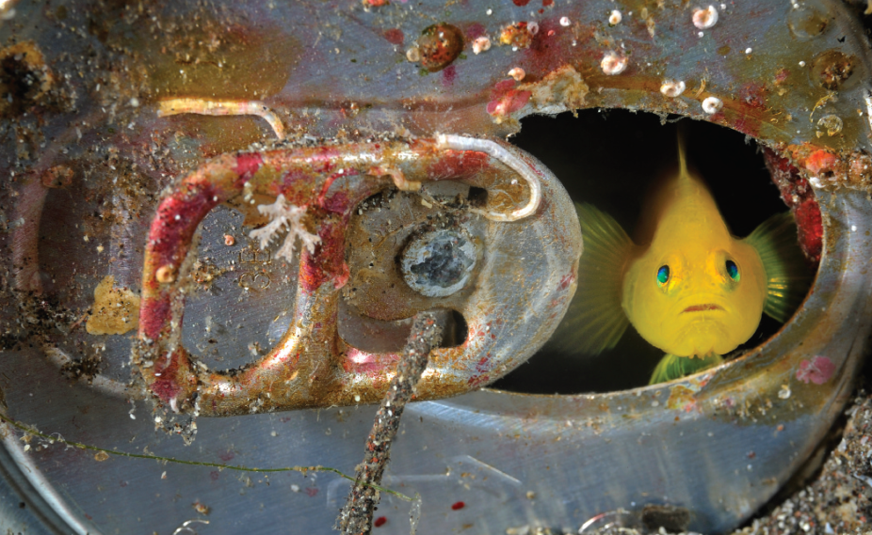
1 Work in pairs. Look at the photo. Discuss the questions.
1 What can you see in the photo?
2 Where do you think this photo was taken?
3 Do you think this is the fish’s natural habitat, a temporary shelter or a permanent home?
Off the Izu peninsula, Honshu, Japan,
a yellow goby looks at the camera.
EXAMPLE ANSWERS
1 It’s a small tropical fish inside what looks like a soda can.
2 Perhaps in the sea, or perhaps inside a fish tank or aquarium.
3 It could be in any of the three suggested places, but it has found something to hide in – an old can – which would not naturally be found in its usual habitat.
Unit 7-p. 81

Slide 3
2 Listen to three people talking about different living arrangements. Write the number of the speaker (1–3) next to the statements that summarize their comments.
Track 54
3
3
2
1
2
1
a I can’t wait to leave my parents’ house and get some independence.
b My family’s lovely, but I’d like to have my own home and some privacy.
c My flatmates aren’t here much, so it’s just like having my own place really.
d It’s cramped and noisy, but at least you’re never lonely.
e Sharing a flat with friends is not as easy as I thought it would be.
f I love living with my mum and dad and brothers. I won’t leave until I get married.
(Speaker 1 = d; f Speaker 2 = c; e Speaker 3 = a; b)
Unit 7-p. 81

Slide 4
Script
Track 54
1
We’re a big family, and it’s quite a small house. I share a bedroom with my two older brothers. My grandparents live with us too. It’s cramped and noisy, but at least there’s always someone around. It’s the only house I’ve ever known. I love living with my family, we all get on so well. I suppose I’ll move out when I get married. I don’t know when that will be!
2
I had to move to London when I started work. I saw an advert in the paper for a room in a shared house. Well it’s a flat on the first floor of a big house, actually. My flatmates are away working quite a lot, so it’s just like living on my own a lot of the time, really … especially during the week. Weekends are different. I have to say that living with friends is more difficult than I thought it would be. For one thing, nobody ever wants to do any housework.
3
I’m in my last year at college and I’m really looking forward to finishing and going abroad or getting out of this town! I can’t wait to get away from here and be independent. It’s going to be brilliant. My sister and I have shared a room all our lives.
My family’s lovely, but I’d like to have the chance of my own space – preferably in a lovely sunny country somewhere.

Slide 5
3 Work in groups. Discuss the questions.
1 Which room do you spend most time in at home?
2 How do different family members use different rooms?
3 Do you consider your home a private place, just for family? Or do you often have friends round?
Students' own ideas
Unit 7-p. 81

Slide 6

7a Before New York
Vocabulary in the city
1 Work in pairs. What kind of a place is New York? Try to describe New York in three words.
EXAMPLE ANSWERS
busy, noisy, world-famous, exciting, crowded, international, cosmopolitan, dangerous, high-rise, nonstop, an exciting place, a cosmopolitan city
7a-p. 82

Slide 7
2 Complete the sentences with these words. Which sentences do you think are true of New York?
1 There’s an excellent _______________ system to get you around the city.
2 It’s got an important business and _____________ district.
3 It’s one of the most _____________ places you can live, with few open spaces.
4 The views from the _____________ are spectacular, especially at night.
5 There’s lots to do, both for tourists and _____________.
6 Some _________________ are more dangerous than others.
7 The _____________ is exciting and lively.
8 The streets divide the city into _____________.
public transport
financial
built-up
skyscrapers
residents
neighbourhoods
atmosphere
blocks
Arguably, all the sentences are true of New York.
7a-p. 82

Slide 8
3 Write sentences about places you know with the words from Exercise 2.
EXAMPLE ANSWERS
In the city centre, the atmosphere in the restaurants is exciting and cosmopolitan.
There’s an extensive public transport system – there are trams and buses to all the suburbs.
My capital city has got a new financial district.
The neighbourhoods in the north are crowded and dangerous.
7a-p. 82

Slide 9
Reading
4 Work in pairs. Discuss the questions. Then read the article Before New York and check your ideas.
1 What do you think the area that is now New York was like before the city was built?
2 What kind of people do you think lived there?
3 What kind of landscapes do you think there were?
7a-p. 82

Slide 10

Track 55
Of all the visitors to New York City in recent years, one of the most surprising was a beaver which appeared one morning in 2007. Although beavers used to be common in the area in the seventeenth century, and people used to hunt them for their skins, there haven’t been any for more than two hundred years.
For ecologist Eric Sanderson, the beaver’s appearance was especially interesting. For ten years, Sanderson has been in charge of a project to show what the area used to look like before the city changed it completely. As Sanderson says, ‘There are views in this city where you cannot see, except for a person, another living thing. Not a tree or a plant. How did a place become like that?’
In fact, long before the skyscrapers came to dominate the view, this place was a pristine wilderness where animals like beavers, bears and turkeys would move freely through forests, marshes and grassland. There used to be sandy beaches along the coasts and ninety kilometres of fresh-water streams.
7a-p. 82

Slide 11

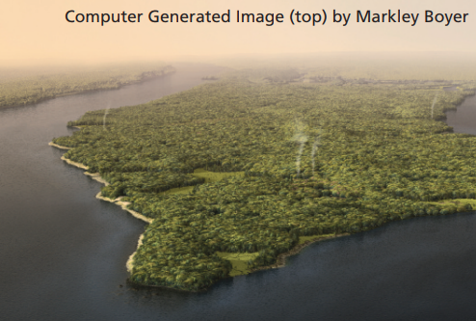
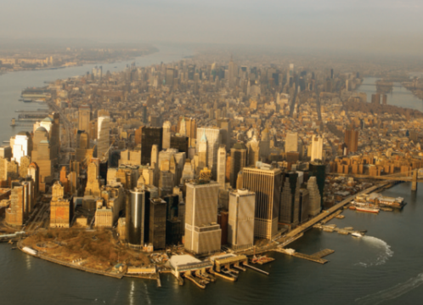
At the end of Sanderson’s project, he built a 3D computer model of the area. (See the top photo on the right.) You can pick any spot in modern New York and see what used to be there. Take Fifth Avenue, for example. A family called Murray used to have a farm here and in 1782 (during the American War of Independence) the British soldiers landed near here. ‘I’d like every New Yorker to know that they live in a place with amazing natural potential – even if you have to look a little harder to see it,’ says Sanderson.
7a-p. 82

Slide 12
Reading
4 Work in pairs. Discuss the questions. Then read the article Before New York and check your ideas.
1 What do you think the area that is now New York was like before the city was built?
2 What kind of people do you think lived there?
3 What kind of landscapes do you think there were?
1 It was a ‘pristine (= unspoilt and pure) wilderness’ of forests, marshes and grassland. There used to be sandy beaches along the coasts and 90 kilometres of fresh-water streams.
2 A family called Murray used to have a farm on what is now Fifth Avenue, and in 1782 the British soldiers landed near there.
3 You could see forests, marshes and grassland, sandy beaches along the coasts and 90 kilometres of freshwater streams.
7a-p. 82

Slide 13
5 Read the article again. Answer the questions in your own words.
1 What’s the connection between Eric Sanderson and the image with the article?
2 What did Sanderson aim to do with his project?
3 Why do you think the appearance of the beaver in 2007 was important for Sanderson?
1 Sanderson, who is an ecologist, built a 3D computer model of Manhattan island to show what the area was like before the city of New York was built. The image shown with the article is of this ‘pristine wilderness’.
2 For ten years, Sanderson has been leading a project to visualize what the area of New York used to look like before the city transformed it. He wants every New Yorker to know that they live in a place with amazing natural potential.
3 There haven’t been any beavers in New York for around 300 years, so the beaver symbolized the New York that Sanderson was trying to recreate with the map.
7a-p. 82

Slide 14
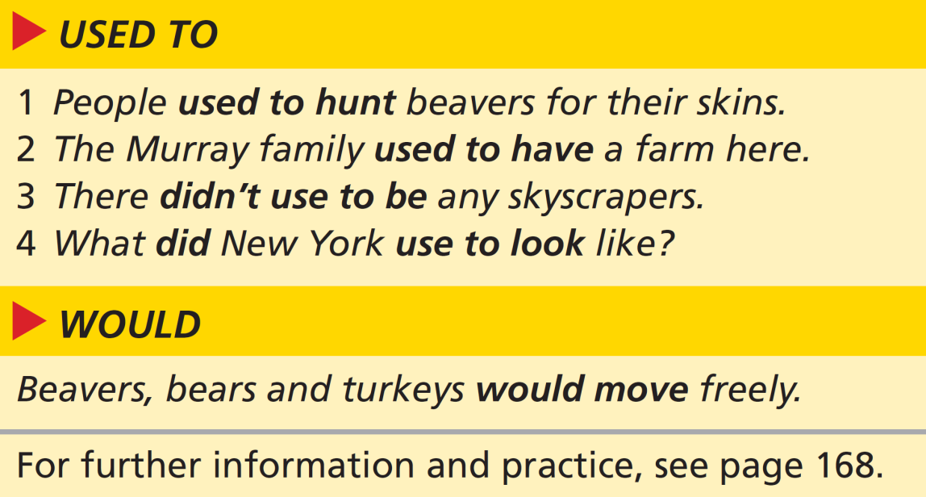

Grammar used to, would and past simple
6 Look at the grammar box and the article. Underline the sentences in the article with used to and would. Do they refer to past habits and states or to single actions in the past?
Past habits: people used to hunt them for their skins; beavers, bears and turkeys would move freely
Past states: beavers used to be common in the area; what the area used to look like; There used to be sandy beaches; see what used to be there; a family called Murray used to have a farm here
7a-p. 83

Slide 15
7 Look at the article again. Find three examples of single actions in the past. What is the verb form?
Examples of single past actions using the past simple:
a beaver … appeared one morning in 2007;
he built a 3D computer model;
the British soldiers landed near here
8 Look at the grammar box. Match the sentences with used to (1–4) with the uses (a or b). Then match the sentence with would with its use.
a past state
b past habit (repeated action)
1 b – past habit (repeated action)
2 a – past states
3 a – past states
4 a – past states
Would b – past habit (repeated action)
7a-p. 83

Slide 16
9 Rewrite the sentences using used to + infinitive where possible.
1 New York was a lot greener than it is now.
2 The early residents didn’t live in a large city.
3 People farmed the land.
4 Farmers hunted wild animals for food.
5 Soldiers fought an important battle on the island.
6 What was in the area where Fifth Avenue is now?
1 New York used to be a lot greener than it is now.
2 The early residents didn’t use to live in a large city.
3 People used to farm the land.
4 Farmers used to hunt wild animals for food.
5 (used to is not possible – it’s a single action in the past)
6 What used to be in the area where Fifth Avenue is now?
7a-p. 83

Slide 17
10 Complete the text with the past simple, used to or would form of the verbs. In some cases, you can use more than one form.
I remember when I first 1 ______________ (move) to New York from California with my parents. Every day for the first month, I 2 ___________________________ (stand) in the street and stare up at the skyscrapers. They 3 _______________ (be) taller than anything I’d ever seen. The streets 4 ______________ (be) much busier than in California and I
5 ____________________________ (run) from one side to the other holding my mother’s hand. For the first few months, we 6 _______________________________________ (not / go) further than four blocks from home. My parents 7 _______________________________ (not / own) a car, so on Sunday mornings we 8 ________________________________ (take) the subway to Central Park. We 9 _______________________________ (have) breakfast at a lovely deli and then we 10 ________________________________ (go) skating. The city 11 ________________________ (be) a lot more dangerous and scary then.
moved
used to stand / would stand
were
were
used to run / would run
didn’t use to go / wouldn’t go / didn’t go
didn’t use to own / didn’t own
used to take / would take / took
used to have / would have / had
used to go / would go / went
used to be / was
See next slide for detailed answers
7a-p. 83

Slide 18
Exercise 10
1 moved (past simple for a single finished action)
2 used to stand / would stand (past habit which is no longer true)
3 were (past simple for past permanent state)
4 were (past simple for past permanent state)
5 used to run / would run (past habit which is no longer true)
6 didn’t use to go / wouldn’t go / didn’t go (past habit which is no longer true)
7 didn’t use to own / didn’t own (past state which is no longer true)
8 used to take / would take / took (past habit which is no longer true)
9 used to have / would have / had (past habit which is no longer true)
10 used to go / would go / went (past habit which is no longer true)
11 used to be / was (past state which is no longer true)
Note that 3 and 4 use the past of be to state a permanent state in the past – you can’t use used to in these cases.

Slide 19
11 Complete the sentences with the past simple, used to or would so that they are true for you. Then work in pairs. Compare your sentences and ask follow-up questions about three of the sentences.
EXAMPLE ANSWERS
1 Before I worked/studied here, I … .
2 When I was in primary school, I … .
3 Before we moved here, my family … .
4 I remember my first holiday. I … .
5 Whenever I had exams at school, I … .
6 In my family, at weekends we … .
7 The first time I went to school alone, … .
8 As a child, I … .
Before I worked/studied here, I used to have a job in a supermarket.
When I was in primary school, I used to / would play with dolls / I’d cry a lot.
Before we moved here, my family lived / used to live in the country.
I remember my first holiday. I went to France and had a fantastic time.
Whenever I had exams at school, I used to get really nervous.
In my family, at weekends we used to / would often have a picnic in the countryside.
The first time I went to school alone, I got lost.
As a child, I used to / would play football in the streets with my friends all the time.
7a-p. 83

Slide 20

Speaking
12 Choose two places from the list. How have the places changed? Make notes for then and now.
• my street
• my home
• my classroom
• my school
• my village / my town
my street: then – lots of cars; now – residents only
13 Work in pairs. Tell each other about the places you chose in Exercise 12. Use used to and would. Decide which places have changed the most and whether they are better now than they were in the past.
A: There used to be a lot of cars in my street, but now only residents can park on it.
B: What do visitors do? Can they drive up to your house?
7a-p. 83

Slide 21
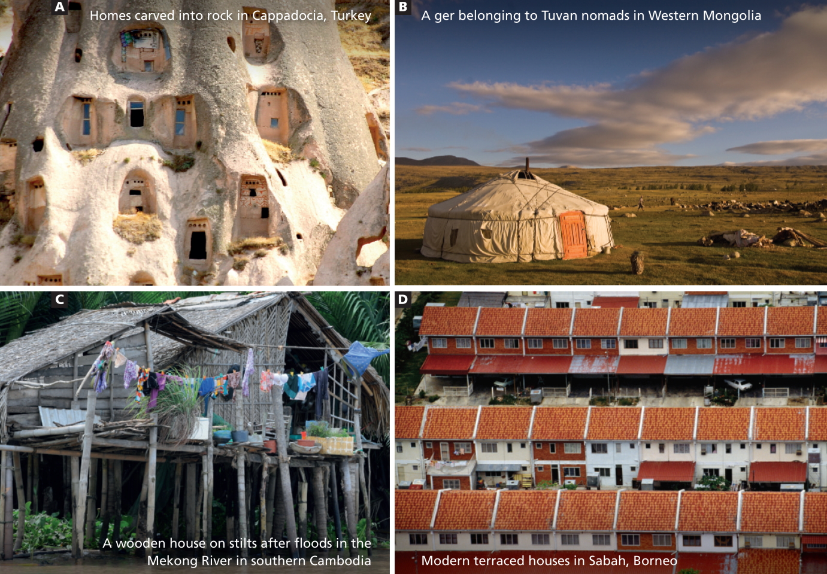
7b Homes around the world
Photo A (houses in Cappadocia): rock
Photo B (ger): cloth and wood
Photo C (river house): wood
Photo D (terraced houses): bricks
Listening
1 Look at the photos of four homes. What are they made of?
7b-p. 84

Slide 22
2 Think of a question you’d like to ask each home owner. Then work in pairs. Tell your partner.
EXAMPLE ANSWERS
Photo A: What tools do you use to build the house?
Photo B: Where do you get the cloth/wood from?
Photo C: How do you heat the place in winter?
Photo D: What are your neighbours like?
3 Marta Fereira presents the TV series Home Planet. Read the questions (a–e) that viewers have sent in to the programme’s website. Then listen and match Marta’s podcast replies (1–5) with the questions.
Track 56
1
a Why are you so interested in traditional house design?
b We live in a new house that my dad calls a ‘box’. What do you think of the design of modern houses?
c Why are some types of house more common in some areas of the world than in others?
d You mentioned shelters in your last programme. What’s the difference between a shelter and a home?
e I’d like to stay in a ger, but they look a bit basic. What are they really like?
5
4
2
3
7b-p. 84

Slide 23
4 Listen again and complete the sentences.
Track 56
1 Traditional houses usually survive bad _____________ conditions better than modern ones.
2 Rock homes heat up less quickly than _____________ _____________.
3 You can put up a ger much faster than a _____________ _____________.
4 You can live much more safely above the _____________.
5 Modern houses are getting smaller and _____________.
6 Unfortunately, sometimes _____________ _____________ are also built badly.
7 Modern houses don’t work as efficiently as ____________ ___________.
weather
brick
houses
wooden
house
water
smaller
modern
houses
Track 56
traditional
houses
5 Which of the homes in the photos would you like to spend time in? Why?
EXAMPLE ANSWERS
The river houses are in a beautiful spot for fishing and going around in boats; the ger might be fun to put up or take down, can be moved to other locations and is a great place to socialize; the rock houses are probably warm and cosy and fascinating to explore.
7b-p. 84

Slide 24
Script
Track 56
1
As an architect, I’m interested in everything about house design. But we can learn so much from traditional buildings and designs. Traditional houses usually survive bad weather conditions better than modern ones, so the question is, what can we copy from those houses when we build new houses? Like the rock homes, you know? They heat up less quickly than brick houses, which is great in hot climates.
2
Well, a shelter is a lot less permanent and more basic than a house. The igloos that people build with ice in the Arctic region are a perfect example of a shelter. A shelter just protects you from the weather, but a home has several spaces with different uses.
3
I’d say a ger is both a shelter and a home. It’s organized around a fire in the centre with a chimney, and it has separate areas for men and women. A ger isn’t as solid as a brick or wooden house but you can take it down and put it up much faster, which is what
nomadic people in Mongolia need.

Slide 25
Script
Track 56
4
Well, it all depends on the local weather. I mean, if you live in an area that has regular floods, it’s a good idea to live in a house on stilts. That way, you can live much more safely above the water and you don’t have to worry every time it rains a lot! And the higher the stilts, the safer you are!
5
I think that modern homes are fairly similar wherever they are in the world, which doesn’t always mean that they are the best design for every situation. In our crowded cities, modern houses are getting smaller and smaller so that they can be built more cheaply. Unfortunately, sometimes modern houses are also built badly. They don’t work as efficiently as traditional houses – they need central heating in winter and air conditioning in summer.

Slide 26
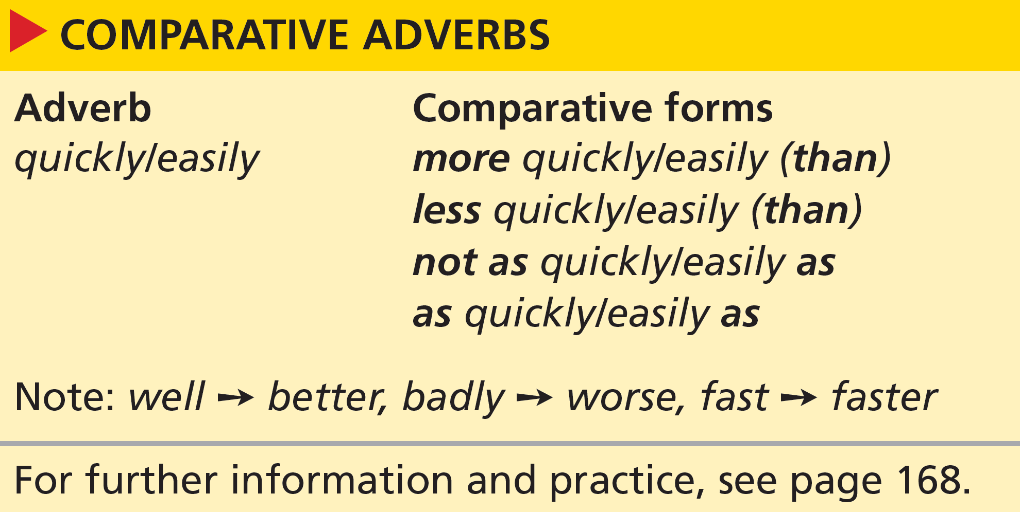
Grammar comparison: adverbs
6 Look at the grammar box. Underline the comparative adverbs in the sentences in Exercise 4.
1 better than
2 less quickly than
3 much faster than
4 more safely
5 smaller and smaller
6 –
7 as efficiently as
1b-p. 13

Slide 27
7 Read the three sentences. Do they mean the same thing? Do you agree with the sentences?
1 A brick house heats up more quickly than a rock house.
2 A rock house heats up less quickly than a brick house.
3 A rock house doesn’t heat up as quickly as a brick house.
All three sentences mean the same thing. The audio says:
They [rock homes] heat up less quickly than brick houses.
7b-p. 85

Slide 28
8 Complete the text about house sales and rentals in the UK with the comparative form of the adverbs.
Last year, terraced houses sold 1 __________________ (quickly) than flats, but one-bedroom flats did 2 __________________ (well) with young buyers. The number of large houses for rent rose 3 __________________ (fast) than other types of home. Sales of large flats did 4 __________________ (badly) than in previous years. So what does this mean for you? You can now rent a large house 5 __________________ (cheaply) than ever before, but if you’re trying to sell yours, you probably won’t find a buyer 6 __________________ (easily) as in previous years. Renting it out is a good alternative, so come and talk to us today.
more quickly
better
faster
worse
more cheaply
as easily
7b-p. 85

Slide 29
9 Write sentences comparing the pairs of things. Then look at your partner’s sentences. Do you agree?
1 young people / older people (drive carefully)
2 girls / boys (do well in exams)
3 children / adults (learn quickly)
4 women / men (work hard)
5 Americans / British people (speak slowly)
6 I / my friends (sing badly)
Older people drive more carefully than young people.
Girls do as well in exams as boys. or Girls (don’t) do as well as boys in exams. or Girls do better than boys in exams. or Girls do less well than boys in exams.
Children learn more/less quickly than adults. or Children (don’t) learn as quickly as adults.
Women (don’t) work as hard as men. or Women work harder/less hard than men.
Americans speak more/less slowly than British people. or Americans (don’t) speak as slowly as British people.
I (don’t) sing as badly as my friends. or I sing worse/less badly than my friends.
7b-p. 85

Slide 30
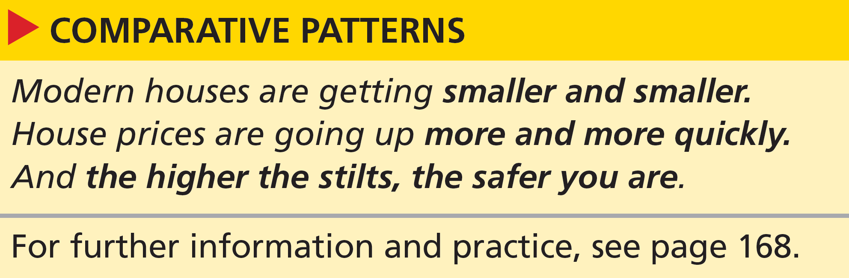
Grammar comparison: patterns
10 Look at the grammar box. Which sentences describe change? Which sentence describes two related things?
Sentences describing change:
Modern houses are getting smaller and smaller.
House prices are going up more and more quickly.
Sentence describing two related things:
And the higher the stilts, the safer you are.
7b-p. 85

Slide 31
11 Read what two people say about where they live. Underline comparative patterns similar to the ones in the grammar box.
Josef: As this building gets older, things go wrong more and more often. But living in a block of flats is really good because I don’t have to worry about repairs and things. Everyone pays an amount each month, so the greater the number of residents, the lower the monthly payment is.
Sandra: We’re all students. So for us, the cheaper the place, the better. We don’t have as much money as people who are working. Rents are getting higher and higher, but you can still rent more cheaply than buy.
go wrong more and more often
the greater the number of residents, the lower the
monthly payment is
the cheaper the place, the better
getting higher and higher
7b-p. 85

Slide 32
12 Complete what two more people say. Use comparative patterns.
Marcus: Neighbours! The 1 ________________________ (few / good), I say. In my old flat, I used to have noisy people living right above me and I got 2 ________________________ (angry) as the months went by. So I moved into my own house and life is much quieter now.
Frances: I love having a garden, but it’s a lot of work – so the 3 ________________________ (small / good), I think. As time passes, the garden gets untidy 4 ________________________ (quickly), until in the end I have to do something about it.
fewer, the better
angrier and angrier
the smaller, the better
more and more quickly
7b-p. 85

Slide 33
Speaking
13 Work in groups of four. Discuss ways of doing these things. What advice would you give someone who wanted to do each one?
EXAMPLE ANSWERS
1 learn English more quickly
2 do better in exams
3 live more cheaply
4 eat more healthily
5 spend more wisely
6 shop more sensibly
work harder; concentrate better in class; do your homework more carefully or conscientiously
eat less often; eat smaller portions; shop more carefully
choose your food more carefully; don’t eat as greedily as you did; cook more and more often
plan your weekly shopping more carefully; the less you go shopping, the less you’ll spend
think more carefully before you buy; the more lists you use, the less you are likely to spend
A: I think you can learn English more quickly if you go to live in an English-speaking country.
B: I agree. You won’t learn as quickly if you stay at home. You won’t meet native English speakers as easily, for example.
7b-p. 85

Slide 34
7c Sweet songs and strong coffee
Reading
1 Think of one word to describe your home town. Tell the class.
Students’ own answers
2 Read the article about a town in Puerto Rico. What is the article mainly about? Choose the correct option (a–c).
a daily life and work
b festivals and holidays
c people and traditions
7c-p. 86

Slide 35

Track 57
There’s a dreamy atmosphere to Adjuntas, a coffee town in the Valley of the Sleeping Giant high in the mountains of Puerto Rico. And there’s love, the love of the people for their land and its customs. People here say their families have lived here ‘since forever’. You feel this love in the streets, with the smell of food cooked at roadside barbecues. You see it in the beautiful horses that parade through town on holidays. And you feel it as you sit in the large, elegant square, with its romantic fountains and stone benches.
Several decades ago, this love of the land also led the local people to prevent a mining development in the surrounding mountains. They used money from the area’s successful coffee production to provide the money for a national park, El Bosque del Pueblo. The park opened in 1998 and runs a reforestation programme allowing young and old to plant trees. ‘Learning to manage the forest has been a kind of new life for us,’ said Tinti Deya, a local resident. ‘It’s another world where we’re like children doing everything for the first time, except in our case we’re grandmothers.’
7c-p. 87

Slide 36
Grandmothers are everywhere in Adjuntas and they’re all respectfully addressed as Dofia. Lala Echevarria, an 85-year-old great-great-grandmother, was born on the oldest street in town, where she still lives in a small, neat and tidy home. Dofia Lala grew up before electricity and running water, and remembers when the first car arrived in Adjuntas. ‘As a child, I used to spend all my time carrying water, finding firewood, looking after the chickens and the cows,’ she said. ‘There were sixteen of us. We would wash our clothes in the river and we used to cook on an open fire. At meal times, we kids would sit on the floor to eat.’ Dofia Lala was working as a maid when she met and married the love of her life, Mariano the mechanic. They had thirteen children and shared 44 years before he died in 1983. She shows me the dozens of photographs of four generations of her family that now fill her tiny home.
People in Adjuntas play old traditional songs in little shops like Lauro Yepez’s place, where men meet to swap stories and have a drink. When I was there, Tato Ramos, a local singer, appeared and began to sing in a flamenco style that hasn’t changed for centuries. The shop quickly filled with working-class men clapping, tapping and nodding to the music. Ramos improvised songs on topics requested by shop customers. ‘This is a forgotten art,’ said Yepez. ‘People give him a topic and he composes a song, in proper rhyme.’
7c-p. 87

Slide 37
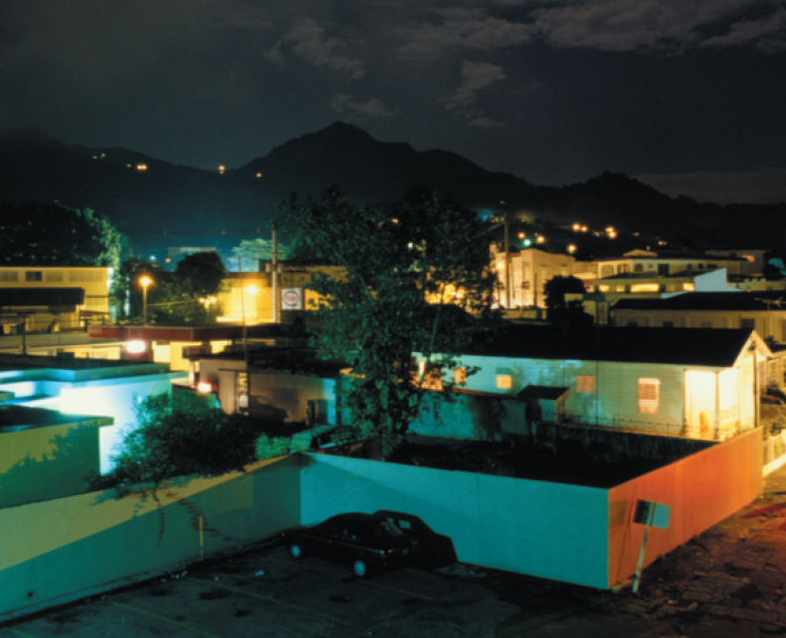
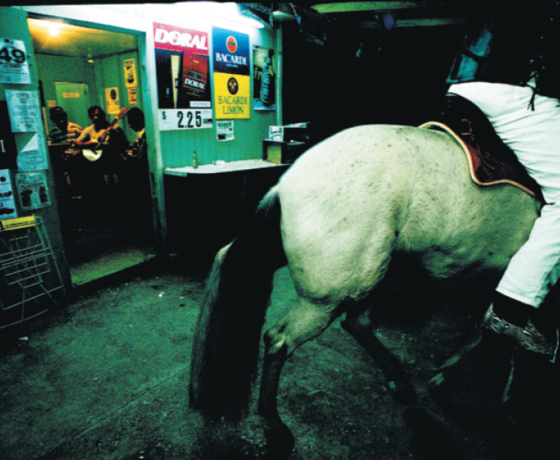
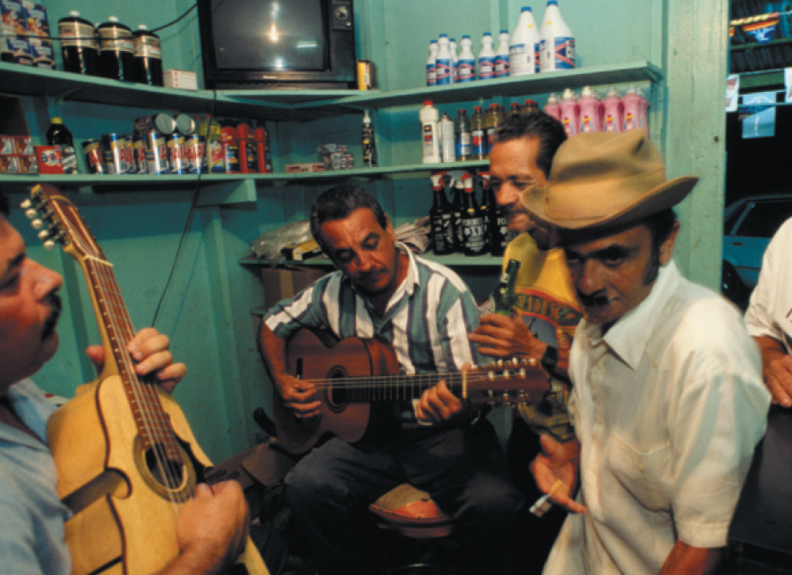
Track 57
Later, I played the recording I’d made for my 88-year-old Spanish father, who has Alzheimer’s disease. His dark brown eyes shone with recognition. He nodded his head, smiled, and said, ‘Oh yes, this I remember, this I remember …’
7c-p. 87

Slide 38
7c Sweet songs and strong coffee
Reading
1 Think of one word to describe your home town. Tell the class.
Students’ own answers
2 Read the article about a town in Puerto Rico. What is the article mainly about? Choose the correct option (a–c).
a daily life and work
b festivals and holidays
c people and traditions
7c-p. 86

Slide 39
3 Which paragraph gives information about:
3
4
2
1
a what life used to be like in Adjuntas?
b a traditional activity that people still do?
c a new activity that people have learned to do?
d what the town looks like?
4 Work in pairs. What can you remember about these things in Adjuntas?
1 the horses
2 the town square
3 Lala Echevarria
4 Tato Ramos
1 beautiful; parade through town on holidays
2 elegant; with its romantic fountains and stone benches
3 85-year-old great-great-grandmother; was born and still lives in a small, neat and tidy home on the oldest street in town; grew up before electricity and running water, and remembers when the first car arrived in Adjuntas
4 a local singer; appeared and began to sing in a flamenco style that hasn’t changed for centuries; improvised songs on topics requested by shop customers
7c-p. 86

Slide 40
5 What do you think of Adjuntas as a place to live? Or a place to go on holiday? Tell your partner and give reasons using information from the article.
Students' own ideas
7c-p. 86

Slide 41
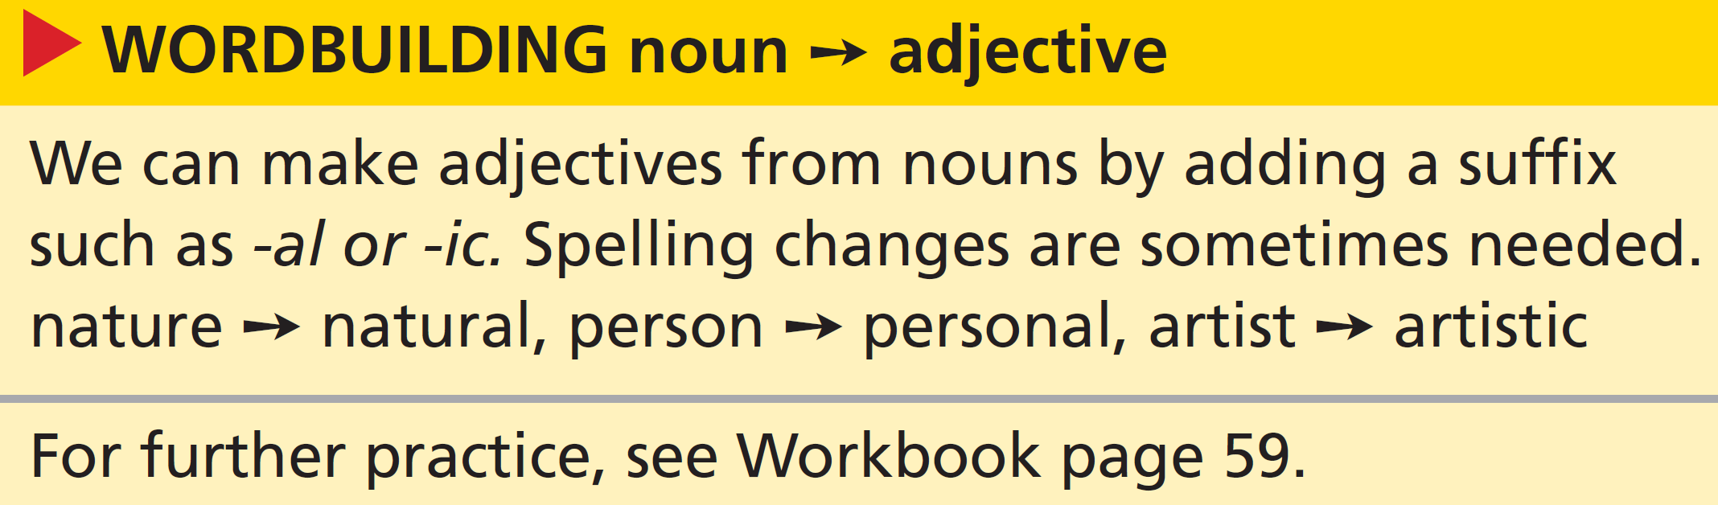
Wordbuilding noun ➙ adjective
6 Look at the wordbuilding box. Find the adjectives in the article that are formed from these nouns.
1 romance (line 10)
romantic
2 nation (line 16)
national
7c-p. 86

Slide 42

7 Complete the sentences with adjectives formed by adding -al or -ic to the nouns.
1 The farmer never stops working. He’s ____________ and enthusiastic.
2 The ____________ part of the island is quite flat and the ____________ part is mountainous.
3 Opening the forest park was ____________ for the villagers and the wildlife.
4 We saw lots of birds in their ____________ habitat.
5 The ____________ crisis hasn’t affected business.
6 The ____________ area of the city around the old market is worth visiting.
energetic
coastal
central
beneficial
natural
economic
historic
7c-p. 86

Slide 43
Critical thinking descriptions
8 The writer aims to ‘paint’ a picture of Adjuntas in the reader’s mind. Which descriptions in the article helped you to build a mental picture of Adjuntas? Underline words and phrases in the article.
EXAMPLE ANSWERS
a dreamy atmosphere …
a coffee town … high in the mountains of Puerto Rico
the smell of food cooked at roadside barbecues
the beautiful horses that parade through town on holidays
the large, elegant square, with its romantic fountains and stone benches
Grandmothers are everywhere in Adjuntas
Lala Echevarria … still lives in a small, neat and tidy home, … remembers when the first car arrived in Adjuntas, … used to spend all my time carrying water, finding firewood, looking after the chickens and the cows, … would wash our clothes in the river and … used to cook on an open fire
we kids would sit on the floor to eat
the dozens of photographs of four generations of her family
men meet to swap stories and have a drink … working-class men clapping, tapping and nodding to the music.
His dark brown eyes shone with recognition. He nodded his head, smiled
7c-p. 86

Slide 44
9 Work in pairs. Compare the words you have underlined with your partner. Do you think the writer has been successful in her aims?
EXAMPLE ANSWERS
The writer has been successful. Point out the number and range of descriptive adjectives (dreamy, elegant, romantic), the way active verbs are listed to suggest a range of activities or movements (carrying water, finding firewood, looking after the chickens; clapping, tapping and nodding) and the way would and used to are used to evoke nostalgia for a time past.
7c-p. 86

Slide 45
10 Add descriptions to each sentence to help the reader build a mental image. Then exchange sentences with your partner.
EXAMPLE ANSWERS
1 The village is in the forest.
2 The houses are small.
3 You can walk through the streets.
4 The village centre is full of people.
5 People are working everywhere you look.
6 From one building, you can hear music.
The tiny village is in the heart of the dense forest.
The old, elegant houses are so small you have to bend down to walk inside.
You can walk through the long, steep streets full of tiny shops selling traditional gifts.
The busy village centre is full of young people on their way to school.
People from all over the world are working in the market everywhere you look.
From one elegant building on the market square, you can hear the beautiful sound of classical music.
7c-p. 86

Slide 46
Speaking
11 Work in pairs. Choose a place that you both know well and that is attractive to tourists. Plan and practise a short presentation to persuade people to visit the destination. Use descriptions that help people to imagine the place. Talk about:
• the best things to see
• the best things to do
• the best places to eat
12 Work in small groups. Give your presentation. Ask and answer follow-up questions.
A: … and finally, don’t leave the area without trying the food at the Golden Lion. It’s delicious and not expensive.
B: Can you tell me what kind of restaurant the Golden Lion is?
7c-p. 86

